Slide 1
Routers and routing

Slide 2
Routing
Routing is the process of moving data across networks
Routing belongs on layer 3 of the OSI model
Uses IP addresses to make routing decisions
Instead of MAC addresses like the switches use
A router is in charge of maintaining tables of information about other routers on the network.

Slide 3
Routing
A static route is one that has been manually configured.
A dynamic route is one that has been implemented dynamically with special routing protocols.
Routing Information Protocol (RIP)
Open Shortest Path First (OSPF)
Interior Gateway Routing Protocol (IGRP)
Border Gateway Protocol (BGP)

Slide 4
Decision making
When a router receives a packet it follows these 3 steps to process it
Checks destination IP
If the router owns the address it will process the packet internally, if not it will look up the destination IP in the routing table
It then identifies the IP address of the next router (next hop), and which interface the data needs to be sent from

Slide 5
TTL
Time To Live is used to prevent routing loops from crashing a network
All packets includes a TTL value within the IP header.
TTL value is how many more hops a packet can go through before it is discarded
When a router receives a packet, it decreases the TTL value by 1.

Slide 6
default + static routes
Since it is impossible to manually route every possible network, most routers use a «default route»
A default route says: if you can’t find a destined network in the routing table, send traffic out this interface and to this other router.
A default route will only get useds if no other route is found
A default route is a static route (manually entered)
Static routes have to be manually entered and changed, which means that if a vital part of the network (next hop on a route) dies, no traffic will get to its destination.

Slide 7
Routing devices
Routers, layer 3 switches, servers and firewalls
An important job for the router is to break up broadcast domains
If this didn’t happen, the Internet would not work because it would be constant broadcasts going everywhere. Broadcasts belongs on a LAN, not WAN
The only exception to this is the DHCP broadcast

Slide 8
Distance vector
Is a way for routing protocols to calculate the «best» route for the data to be transmitted, by counting how many hops (routers) the data has to go through to get to the destination.
Distance Vector routing protocols:
Routing Information Protocol (RIP) v1, v2 and ng
Interior Gateway Routing Protocol

Slide 9
Link state protocols
Link state routing protocols factor in bandwidth, delay, jitter and load (one or more) when making forwarding decisions.
Routers configured with a link state routing protocol will exchange information regarding the stats of each link, and create a map.
The two most common Link State Protocols are
Open Shortest Path First
Intermediate System to Intermediate System (IS-IS)

Slide 10
Hybrid protocols
A protocol that uses both link state and amount of hops to make forwarding decision is called a Hybrid Protocol
The main Hybrid Protocol is Enhanced Interior Gateway Routing Protocol (EIGRP)

Slide 11
Path Vector
The main difference between a path vector routing protocol and the rest, is that a path vector protocol doesn’t know the complete path, it only knows the next hop.
The only routing protocol under this category is Border Gateway Protocol (BGP) which is the main routing protocol of the internet.

Slide 12
IGP vs EGP
IGP or Interior Gateway Protocol, is a term referring to any protocol responsible for routing within an AS
EGP or Exterior Gateway Protocol, is used to route traffic between different AS
An AS (Autonomous System) is a collection of network owned by one organization

Slide 13
NAT – Network address translation
NAT is the only reason why private addresses work.
Since private addresses are not routable across the internet, a public address is needed
This is done by «Translating» an IP from Private to public.
There are three methodsof NAT
Static NAT – Each Private address has a public address mapped.
Dynamic NAT – One pool of Public addresses are available, first come first serve
Port Address Translation – All private addresses on a network are mapped to one public address

Slide 14
QoS – Quality of Service
Routers can prioritize network traffic
Typical data that could get prioritized
Media Streaming
Voice over IP (VoIP)
Teleconferencing
Safety system traffic

Slide 15


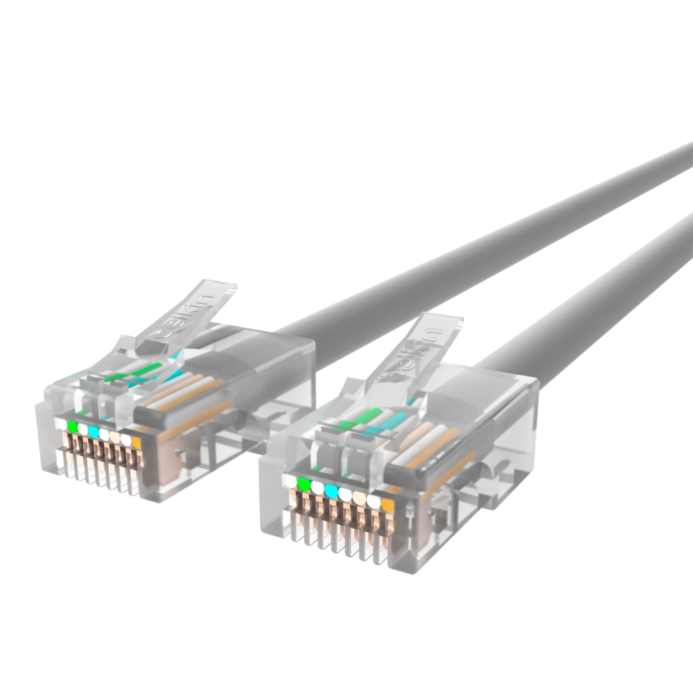
Media types – Connecting everything together

Slide 16
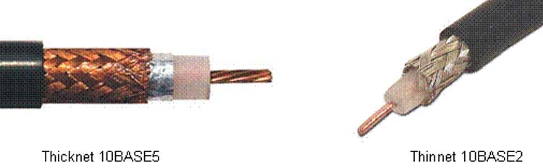
Coax
Copper core
Insulator
Copper shield
Plastic jacket
The cable needs an insulator and «shield» to prevent EMI
EMI is electromagnetic interference
Often an issue with copper cables

Slide 17
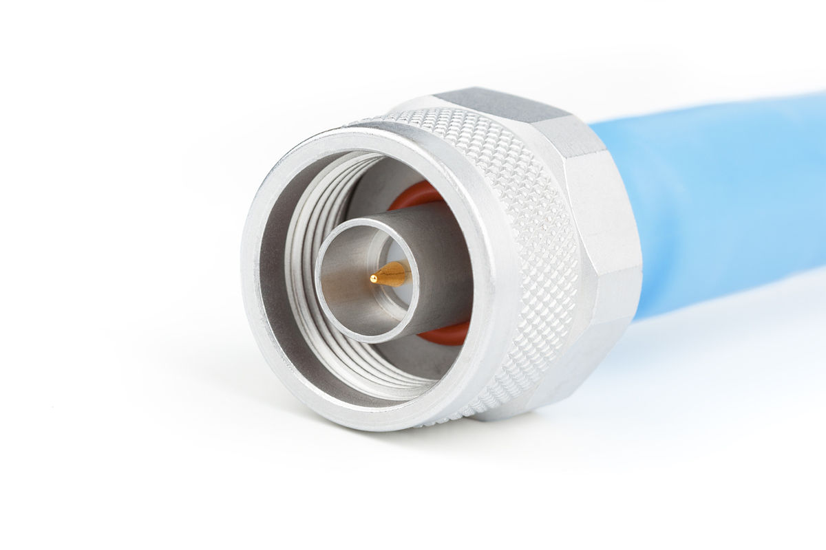
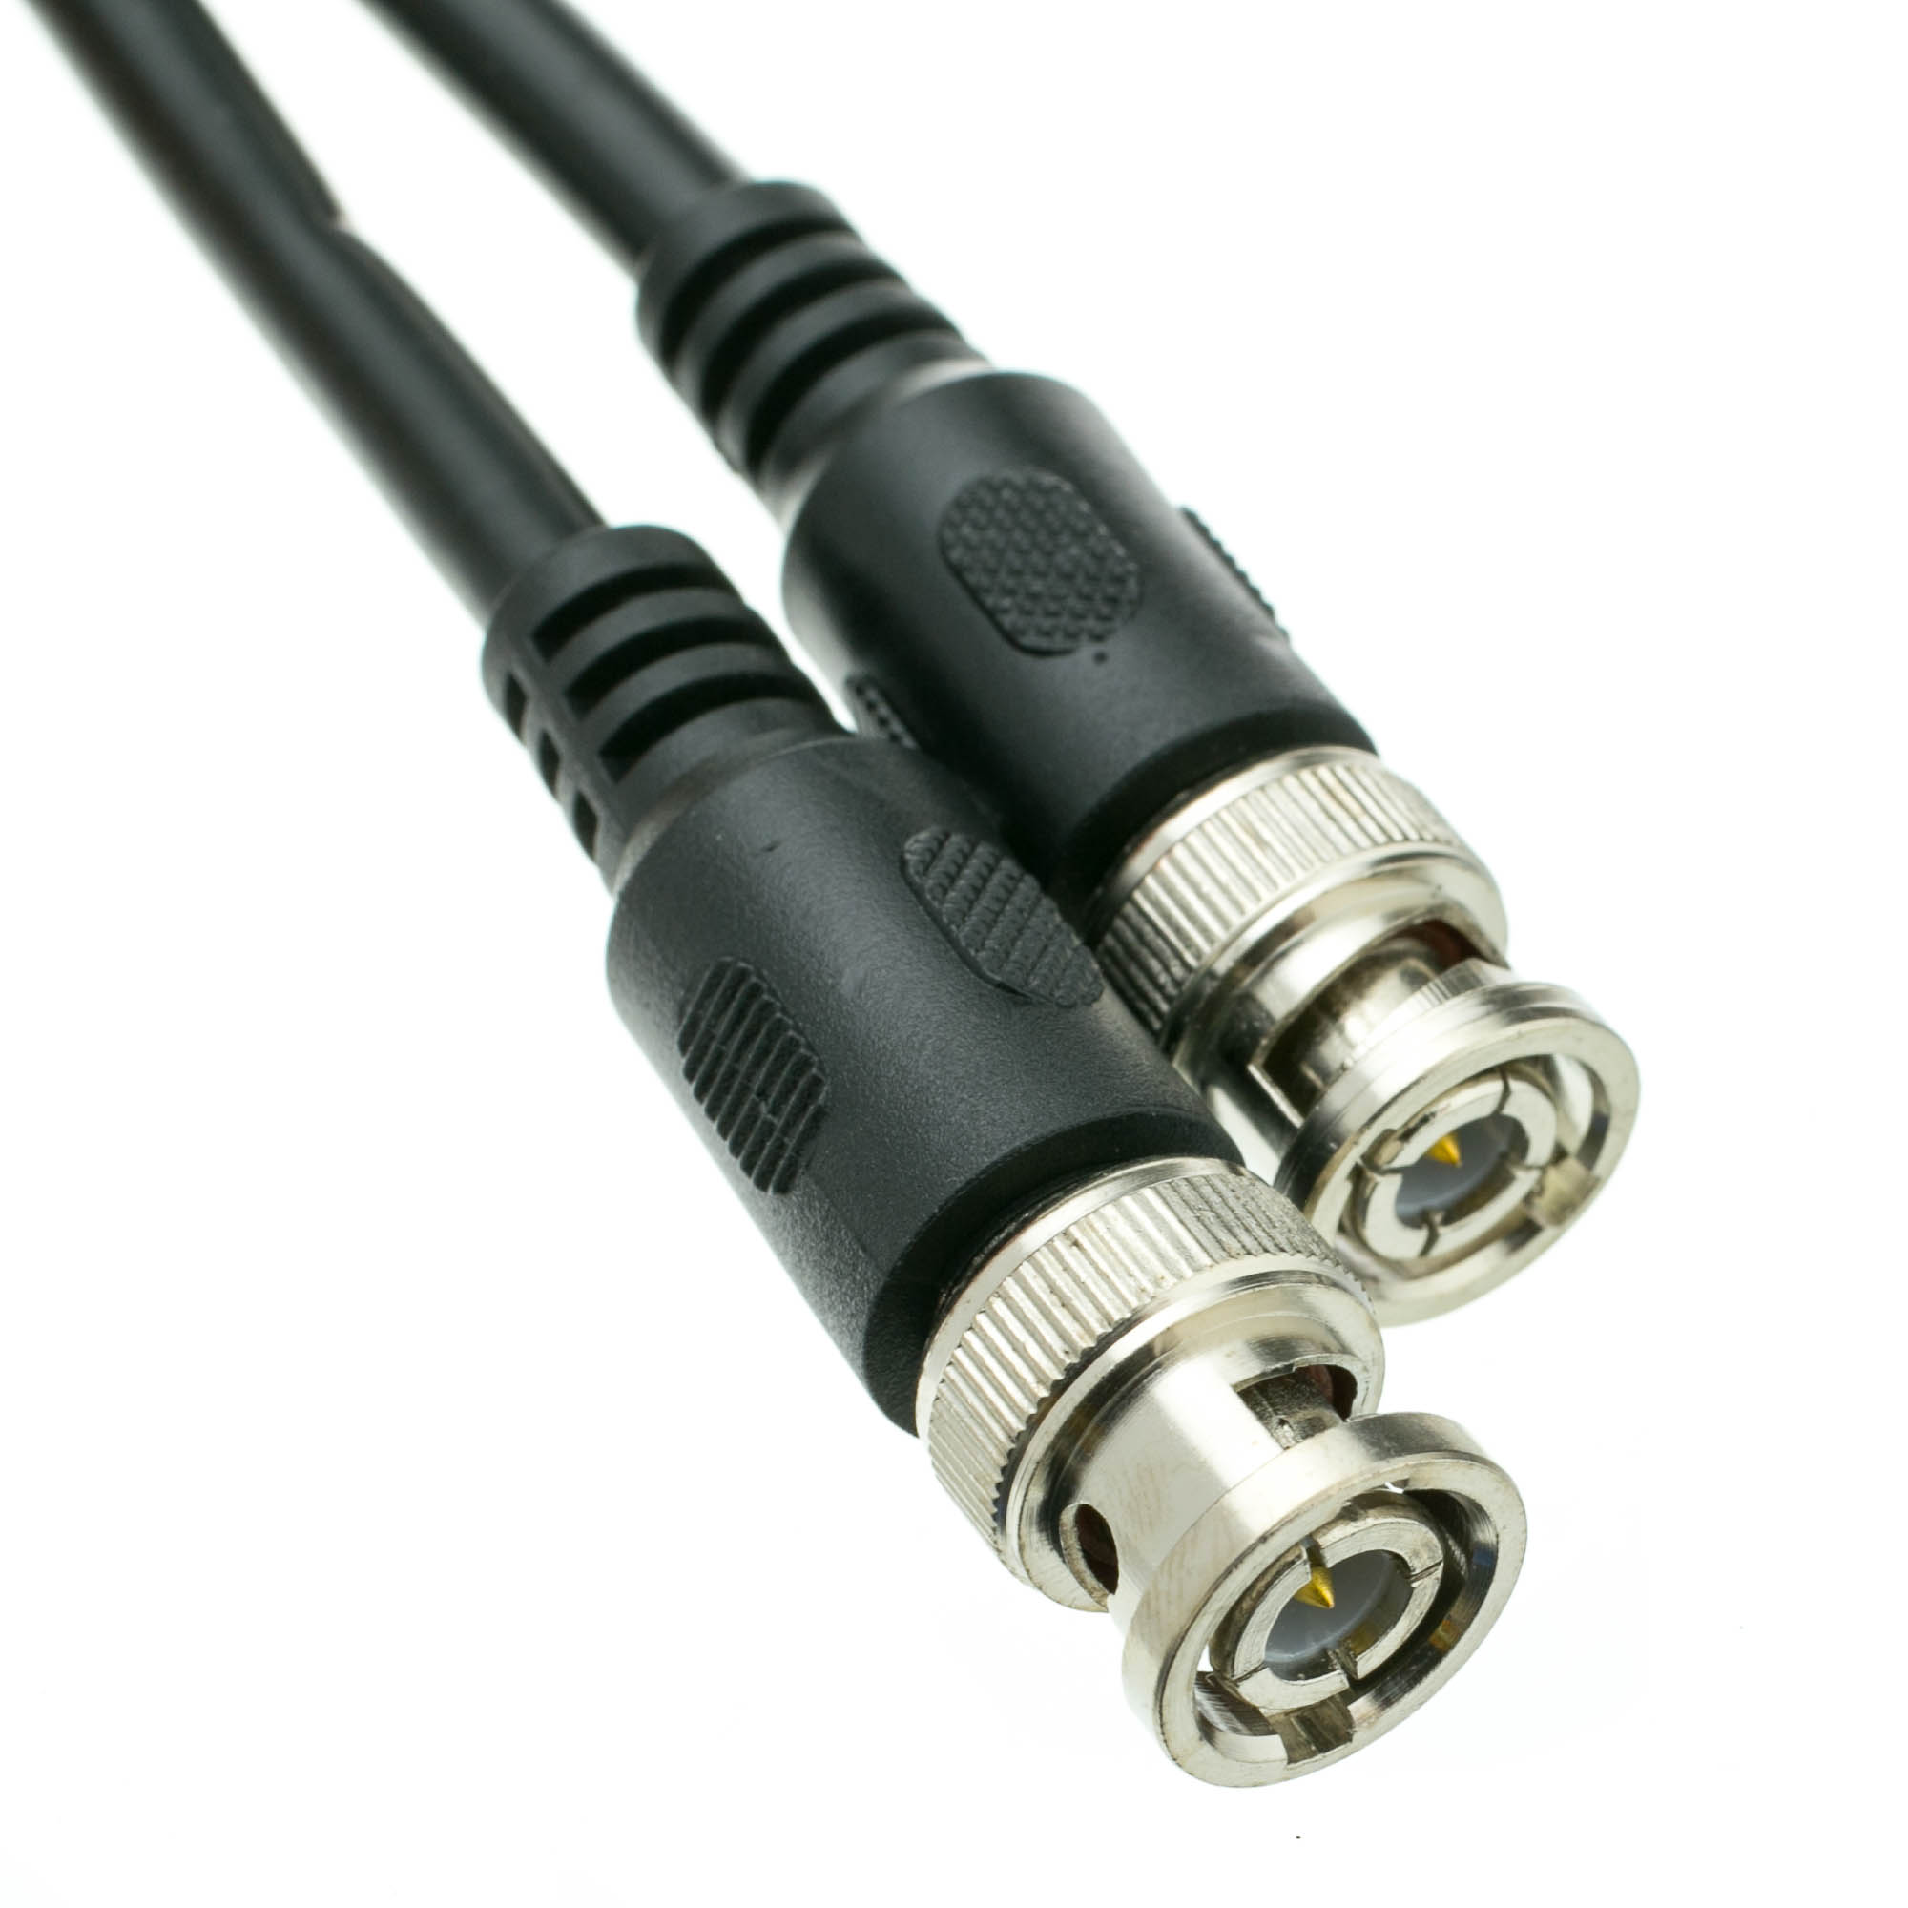
Coax cable types - 10Base5 and 10base2
10base5 – aka thicknet
10Mbps
Up to 500m range
RG-8 cabling
10base2 – aka thinnet
10Mbps
Up to 185m range
RG-58 cabling

Slide 18
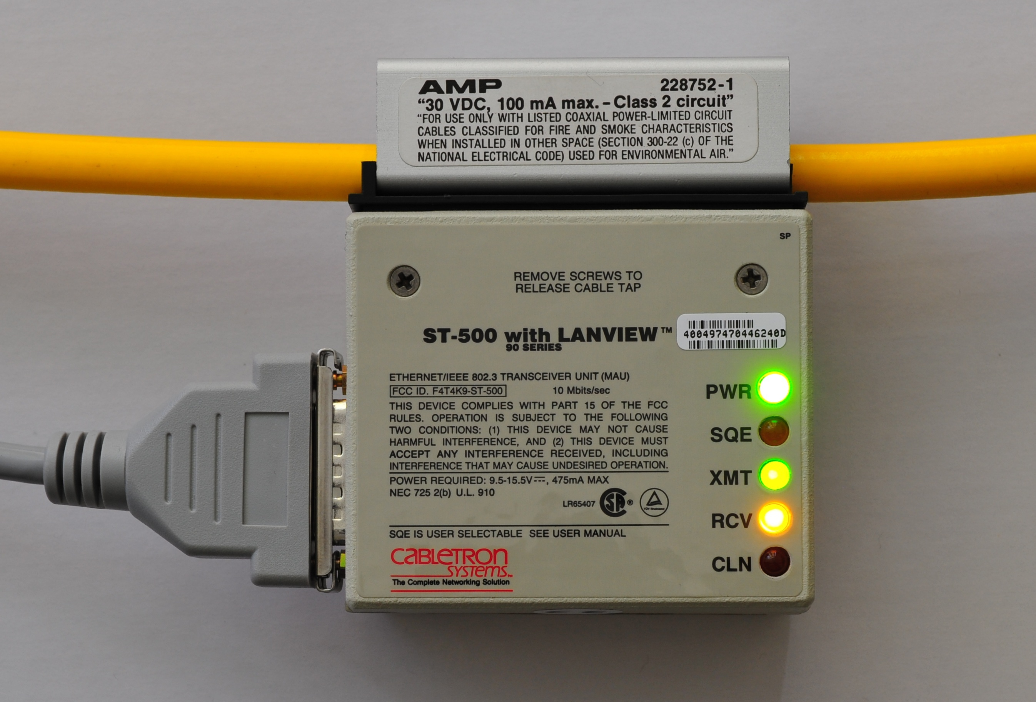
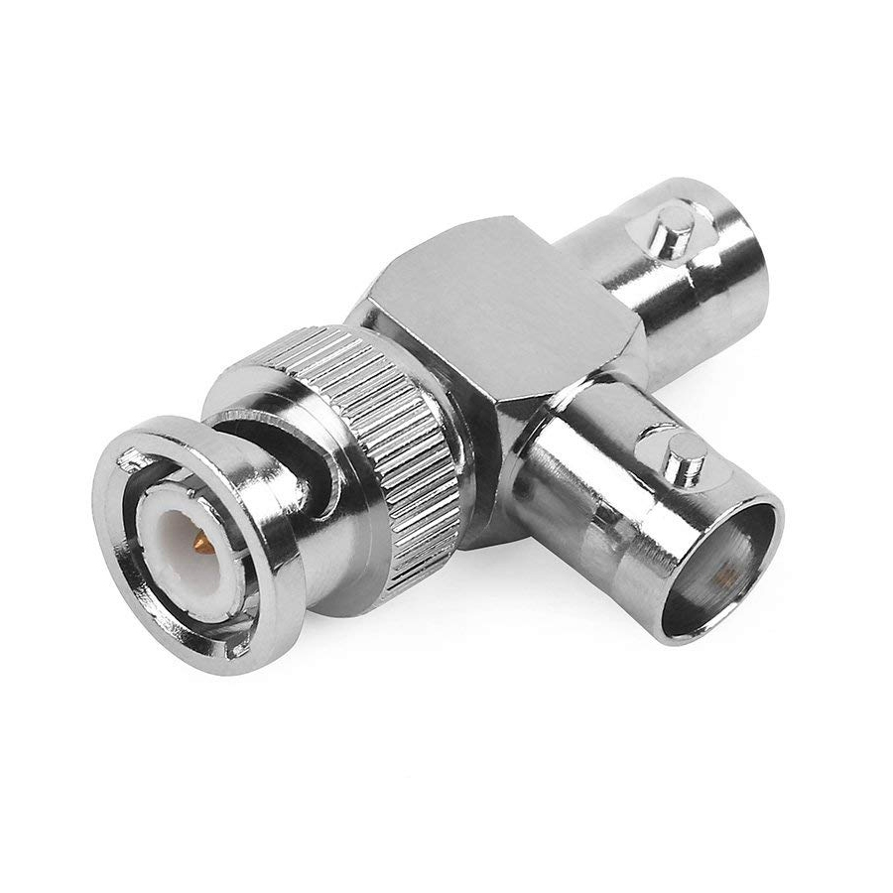

Slide 19
Twisted-pair cables
Twisted-pair cable is the cable most commonly used in local area networks.
It’s relatively easy to work with, flexible, efficient, and fast.
Maximum cable length is 100m
A single twisted-pair cable has eight wires; they are copper conductors that transmit electric signals.
These create EMI (interference)
The wire pairs are twisted to reduce crosstalk
Crosstalk is when a signal from one wire affects the signal in another

Slide 20
Speed
Category | Nomenclature | Speed
Cat 3 | 10baseT | 10 Mbps
Cat 5 | 100baseT | 100 Mbps
Cat 5e | 1000baseT | 1000 Mbps
Cat 6 | 1000baseT | 1000 Mbps (only up to 55m)
Cat 6a | 10GbaseT | 10 Gbps
Cat 7 | 10GbaseT | 10 Gbps
Cat 7a | 10GbaseT | 10 Gbps

Slide 21
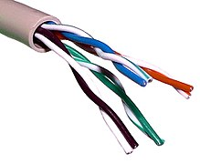
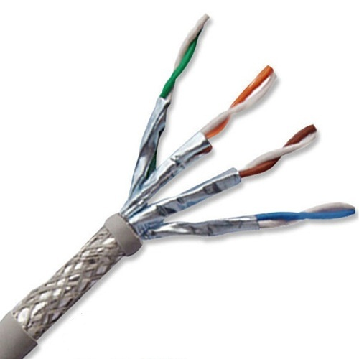
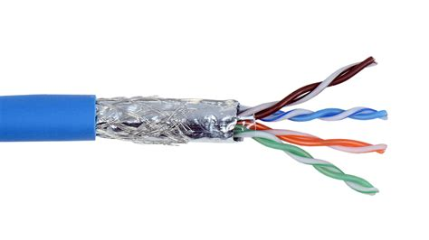
TP
Unshielded twisted pair
Shielded twisted pair
Screened twisted pair

Slide 22
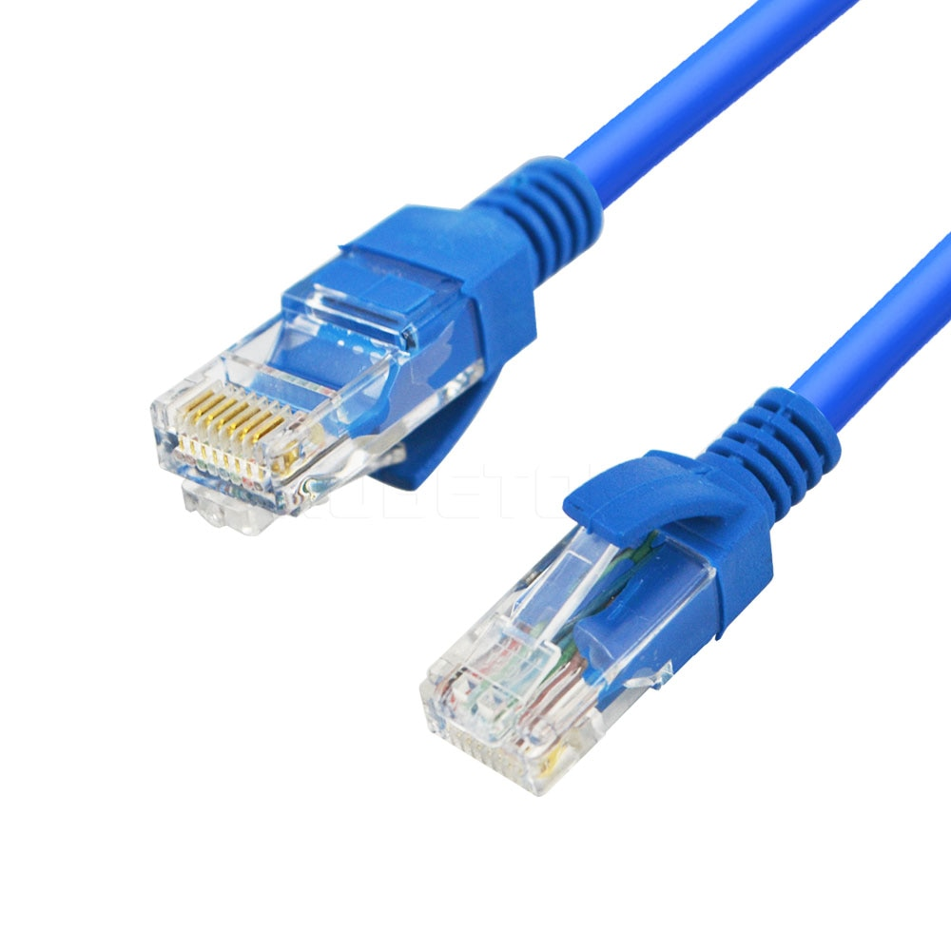

Slide 23
Plenum coating
All types of twisted pair cables can have a plenum coating
This is used in heating, ventilation and air-conditioning conduits to prevent the release of toxic fumes.

Slide 24
Power over ethernet
Some twisted pair cables can be used to power low powered devices through the same cable.
Often used to power Wireless access points.

Slide 25
Different ways to connect TP cable to rj45 connector
Straight-through
Crossover
Rollover
Used to connect dissimilar devices
PC to hub/switch
Switch to router
Used to connect similar devices
PC to PC
Switch to switch
Router to router
PC to router
Used to connect to the console port when you manage network devices

Slide 26
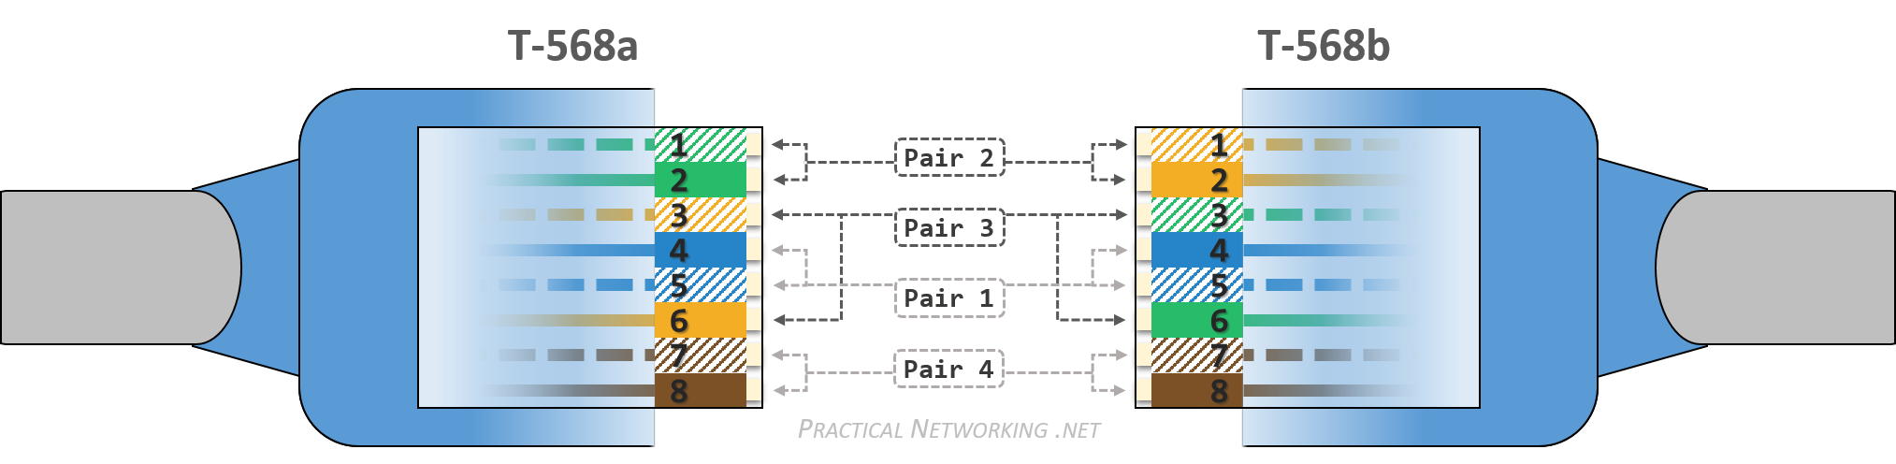
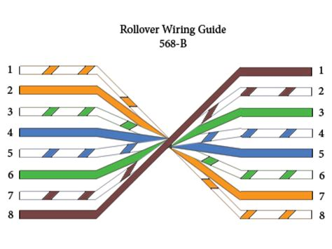
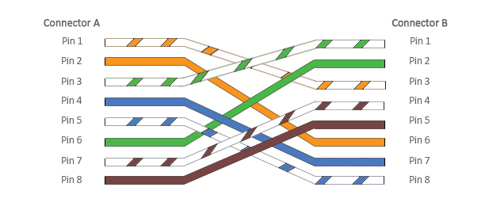

Slide 27
Fiber optic cables
Fiber optic cable transmits light (photons) instead of electricity, and this light is transmitted over glass or plastic.
Glass is known as the media for fiber optics, just like copper is known the media for twisted-pair cabling.
The glass or plastic strands in fiber optic cabling are extremely small

Slide 28
Types of fiber optic cable
Single-mode
Fiber optic (SMF) is a cable with an optical fiber that is meant to carry a single ray of light—one ray of light, one mode.
This type of cable is normally used for longer distance runs, generally 10 km and up to 80 km.

Slide 29
Types of fiber optic cable
Multi-mode fiber optic (MM)
Cable with a larger fiber core, capable of carrying multiple rays of light.
This type of cable is used for shorter distance runs, up to 600 meters.
Though much shorter than single mode fiber runs, this is still six times the distance of twisted-pair cable runs.

Slide 30
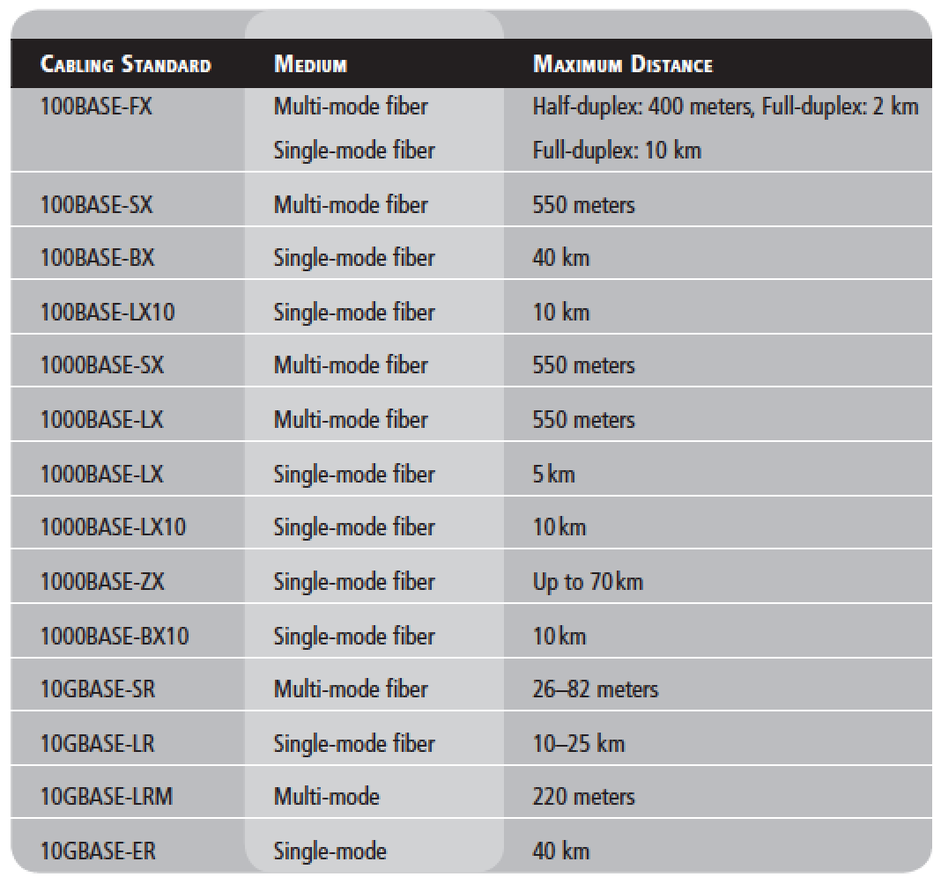
Different standards
Note
You do not need to know all these for the exam, the main thing is differentiating Singlemode from Multimode

